Slide 1
Oracle EBS Key Concepts

Slide 2
Agenda
R12 EBS Introduction
Introduction
Multi-Organization Structure
Key flex field
Primary ledger, Secondary ledger and Reporting Currency
Responsibility
Profiles
Flexfields
Multi-Org Access Control

Slide 3
Introduction
A successful implementation of Oracle applications depends primarily on defining your organizational structure in the multi-level hierarchy used by Oracle Applications.
Business Group
Legal Entity
Ledger
Operating Unit
Inventory Org

Slide 4
Organization Structure
Business Groups
LE1
Ledger1
Ledger2
LE2
Ledger3
Operating Unit4
Operating Unit1
Operating Unit2
Operating Unit3
Inventory Organization

Slide 5
Business Group
Highest level in the organization structure.
At least one BG per Oracle installation.
No impact on accounting
Enterprise, Operating Company , Major Division
The number of business groups depends on the below factors
You are a holding company or a corporation with a number of subsidiary companies. Each subsidiary has its own structures, employees, and compensation and benefit policies. If your subsidiaries are in different countries you also have to deal with local legislative requirements.
You are acquiring a company or merging with another company, and you want to maintain separate structures and compensation and benefits.

Slide 6
Legal Entity
An organization that represents a legal company for which you prepare fiscal or tax reports. You assign tax identifiers and other relevant legal company information to this entity

Slide 7
Operating Unit
Oracle sub ledger modules information is secured at Operating unit level
An organization that partitions and uses data for oracle sub ledger modules like Payables, Purchasing, Order Management, Cash Management, Fixed Assets and Receivables.
Each user can access, process, and report on data only for the operating units to which they have access.
Responsibility
Profiles
MO: Operating Unit – Single OU access
MO: Security Profile – Multiple OU access

Slide 8
Inventory Organization
An organization that tracks inventory transactions and balances, and/or that manufactures or distributes products or components

Slide 9
Key Financial Modules in EBS
General Ledger
Account Payables
Account Receivables
Cash Management
Fixed Asset

Slide 10
Chart of Account – Segment Qualifiers Account Code Combination - CCID
Balancing Segments
Natural Account Segment
Assets
Liabilities
Revenue
Expenses
Ownership
Cost Center
Management Segment
Inter Company Segment
Secondary Tracking Segment

Slide 11
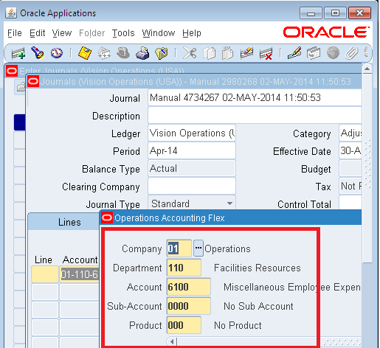
COA - Example

Slide 12
Calendar
Fiscal Year - Fiscal year starting from Jan to Dec or April to Mar
Calendar - It consists of 12 months – fiscal year break into 12 months

Slide 13
Currency
Currency – There are two type of currency , functional currency and foreign currency
Functional currency – Transaction are recorded in functional currency in that country where it operate business. It is assigned primary ledger.
Foreign currency – Other than functional currency , all other currency are foreign currency.

Slide 14
Accounting Convention
Accounting Convention - Sub ledger Accounting method
Method of Account for representing the Financial statement.

Slide 15
Primary Ledger
The Ledger represents accounting representation for an organization
It consist of 4 ‘c
Chart of Account
Calendar
Currency
Sub ledger Accounting method

Slide 16
Secondary Ledgers
Secondary Ledger represent the primary Ledger’s accounting data in another accounting representation that differs in one or more of the following ways:
1) Chart of Accounts
2) Calendar
3) Currency
4) Sub ledger Accounting method.

Slide 17
Reporting Currency
If you want to maintain your ledger transactions in multiple currencies, you can use reporting Currencies.
Reporting currencies are additional currency representations of primary or secondary ledgers.
Reporting currencies can be used for supplementary reporting purposes

Slide 18
Key and Descriptive Flex fields
Key Flex field – combination of user defined segments which is meant for capturing meaningful information.
Segment: It identifies key business objects of the entity ,such as company, department, location, product, account etc..
Value set : It is the container of values. It is used to restrict the value entered by user. It can be of any type ( char, num etc..) based on the setup.
Descriptive Flex field - It is used to capture additional information which is not stored in the default application, or for reference when viewed on a most of the screen. [ ], Attributes

Slide 19
KFF (Key Flexfields) Examples
GL
Accounting Flexfield
AR
Sales Tax Location Flexfield
Territory Flexfield
FA
Location Flexfield
Asset Key Flexfield
Category Flexfield

Slide 20
Accounting Key Flex field
Accounting Key Flex field:
It is the key flex field for the oracle General Ledger application.
Chart of accounts is called the Accounting Flex field.
It is important for the company financial reporting and to record and maintain the transactions using the account code combination.

Slide 21
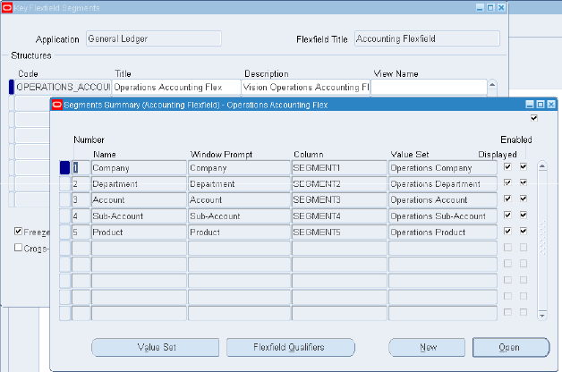
Accounting Flex field Setup
Accounting Flex field Structure
Segments
Value Sets
Values
Flex field Qualifiers
Freeze Flex field Definition
Compile

Slide 22
Responsibility
A responsibility is a level of authority in Oracle Applications that lets Applications users access only those functions and data appropriate to their roles in the organization.
Responsibilities allow access to a specific product, operating unit, ledgers, and a restricted list of windows, functions, reports, and groups of products, or data groups.

Slide 23
Responsibility
How much of an application’s functionality a user can use
What reports and concurrent program a user can access
Which application data these reports and concurrent programs can access

Slide 24
Profiles
A profile is a set of changeable options that affects the way Oracle Applications looks and behaves.
A system administrator can set profile values at site, application, responsibility, and user levels
A value set at the higher level overrides the one set at the lower level. “User” is the highest level.
User
Responsibility
Application
Site

Slide 25
Create User and Assign Responsibility
Create User and Assign Responsibility
Switch to System Administrator responsibility
Navigate to Security-->User-->Define
Add or query an User.
Add responsibility to user as required.

Slide 26
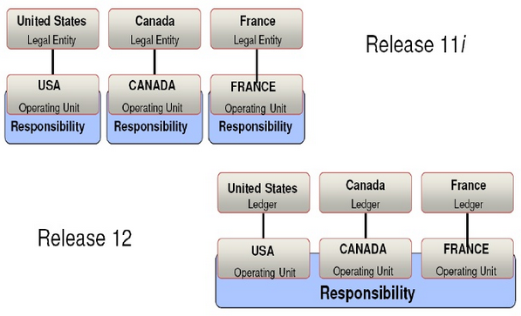
Multi-Org Access Control

Slide 27
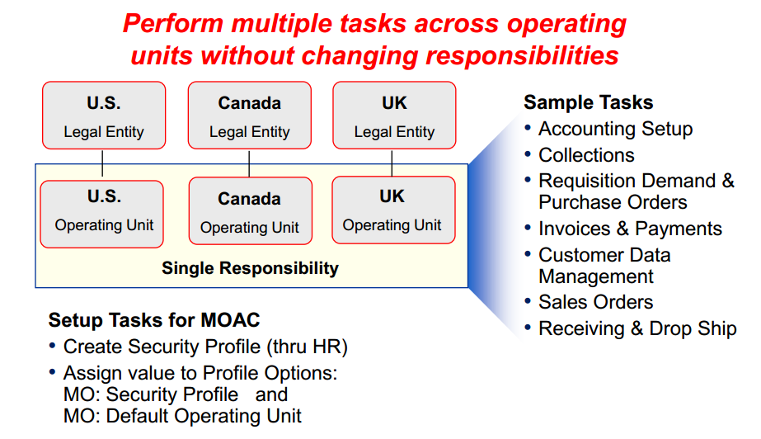
Multi-Org Access Control

Slide 28
Multi-Org Access Control
MOAC enables user to access more than one operating unit from a single responsibility.
For a responsibility to access only one operating unit, then set the profile option called MO: Operating Unit.
For a responsibility to access multiple operating units, then define a security profile with multiple operating units assigned and assign it to the profile option, MO: Security Profile.
Set the MO: Default Operating Unit profile option to specify a default operating unit that will default in transaction entry pages

Slide 29
Components
The components are,
Forms
Menus
Programs
Reports
OAF Page

Slide 30
Forms
A form is a user interface to insert ,update and delete data into and from database. After development , a form must be registered with Oracle Application Object Library.
A form executable (the fmx file) should be placed under the proper application top directory eg. XXX_TOP/forms/US where XXX is the application short name for a given application.

Slide 31
Menus
A menu is a hierarchical arrangement of application functions, that is displayed in the navigator window.
A menu consists of menu entries , which could be a submenu or a function.
Form functions are selected and navigated to using Navigator window.
Each responsibility has a menu associated with it depending on the menu name associated with a responsibility.

Slide 32
Menus
Query the menu name to find the menu entries.
Add your functions as menu entries here or create a new menu with your functions and add that as a sub- menu here.
Now you switch the responsibility and check whether your menu entry is appearing in corresponding responsibility.

Slide 33
Request Group
A request group is a collection of reports and concurrent programs.
A system administrator defines request group in order to control user access to reports and concurrent programs.
Assign the request group to responsibilities from which reports and programs to be submitted

Slide 34
Concurrent Programs
A concurrent program is an executable file that runs simultaneously with online operations
The various steps to define and register a concurrent program are..
Define concurrent program executable
Define concurrent program
Include the concurrent program in a request group
Run concurrent program through submit request form.

Slide 35
Concurrent Program
Define a concurrent program,
Choose an executable created, which will be executed once this concurrent program is scheduled to run.
Parameters
The parameters are the placeholders for the input values to a concurrent program.
If the execution method of a concurrent program is Oracle Reports then each parameter is linked to the actual report parameter via the “Token” field in the parameters window
For PL/SQL stored procedures these parameters are passed to the program by position

Slide 36
Request Sets
Request Sets are a method of grouping multiple reports and/or concurrent programs by business function with common run and print options.
The various tasks of the request set are linked together to determine the execution order, whether the tasks execute sequentially or in parallel.
Stage is a component of a request set used to group requests within the set. All requests in a stage are run in parallel, while stages themselves are run sequentially in the set.
Tasks that must operate separately are created in different stages.
After defining the initial stage for execution, all subsequent stages are defined under the three completion status codes for the previous stage.

Slide 37
THANK YOU

